Slide 1

Water Quality Analysis
Improving water quality is critical in safeguarding human health, ecosystems and the economy. This presentation explores tools and concepts used in evaluating water quality.

Slide 2
Importance of Monitoring Water Quality
1
Human Health
Waterborne diseases affect millions of people annually, resulting in death, sickness, and economic losses.
2
Environmental Health
Poor water quality leads to the death of aquatic life, reduction in biodiversity, soil degradation, and habitat destruction.
3
Public Perception
The public demands better access to clean water and expects responsible management of water resources.

Slide 3
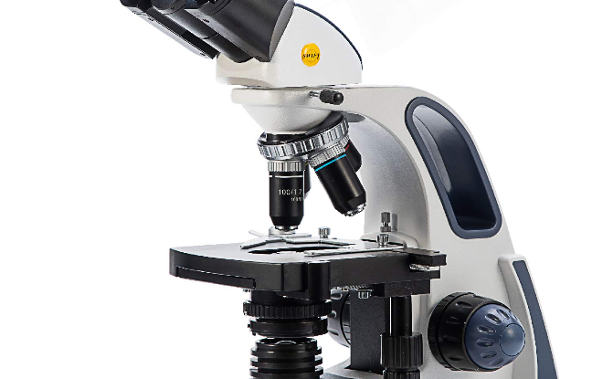

Parameters and Methods for Assessment
Parameters to Measure
Analytical Methods
The most important parameters to measure are pH, temperature, total dissolved solids, total suspended solids, turbidity, and electrical conductivity.
Water quality analysis involves complex analytical methods, including spectrophotometry, chromatography, and electrochemical analysis.

Slide 4

Understanding Water Quality Standards
1
National Standards
These are guidelines developed by governments to protect public health. Examples include the Clean Water Act in the US and the Water Framework Directive in the EU.
2
International Standards
These are set by international organizations like the World Health Organization and the Environmental Protection Agency. They set minimum standards for water quality suitable for human consumption and aquatic life.

Slide 5
Impacts of Poor Water Quality
1
Health Risk
Impurities pose a health risk to humans, causing moderate to severe conditions, including fever, gastroenteritis and hepatitis.
Environmental Damage
2
Poor water quality has a far-reaching impact on plant and animal life with potentially long-lasting environmental damage.
3
Economic Costs
The cost of preventing and remedying water contamination can run into billions of dollars, causing decreased economic growth and increased taxes.

Slide 6
Benefits of Water Quality Analysis
Identification of Contamination Sources
Improved Management of Water Systems
Water quality analysis helps identify contamination sources, allowing for the implementation of targeted remediation efforts.
The insights gained from water quality analysis help manage water quality by developing management plans and ensuring regulatory compliance.
Early Detection of Contamination
Reduced Health and Environmental Impacts
Water quality analysis helps detect contamination when it's still manageable, thus enabling early action for remediation.
The water treatment process, informed through water quality analysis, functions to remove contaminants and reduce the impacts of poor water quality.

Slide 7
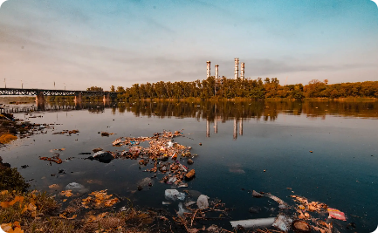


Case Studies and Success Stories
Water Treatment
Conservation and Restoration
Professional Development
The Thames River was highly polluted in the 1980s. However, through regular water quality analysis, the water treatment plant minimized the effluents, thus producing cleaner water today.
A team of professionals conducted a comprehensive water quality analysis on the ocean waters near Sydney, thus enabling informed decision-making by the policymakers.
The Save Our Springs Alliance undertook springs restoration efforts, deemed successful through proper water quality analysis and monitoring.

Slide 8


Slide 9
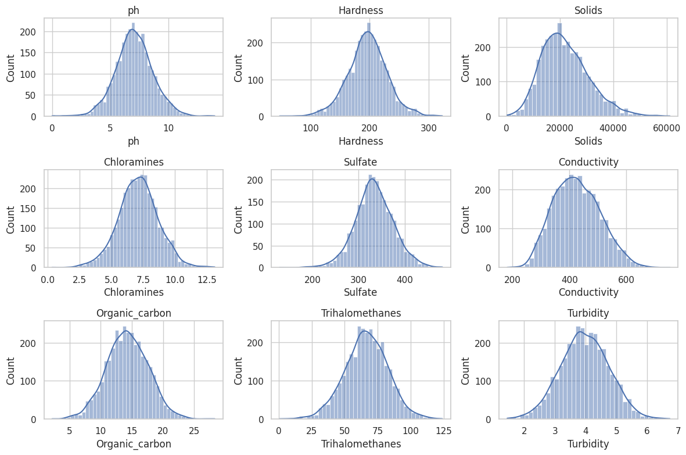
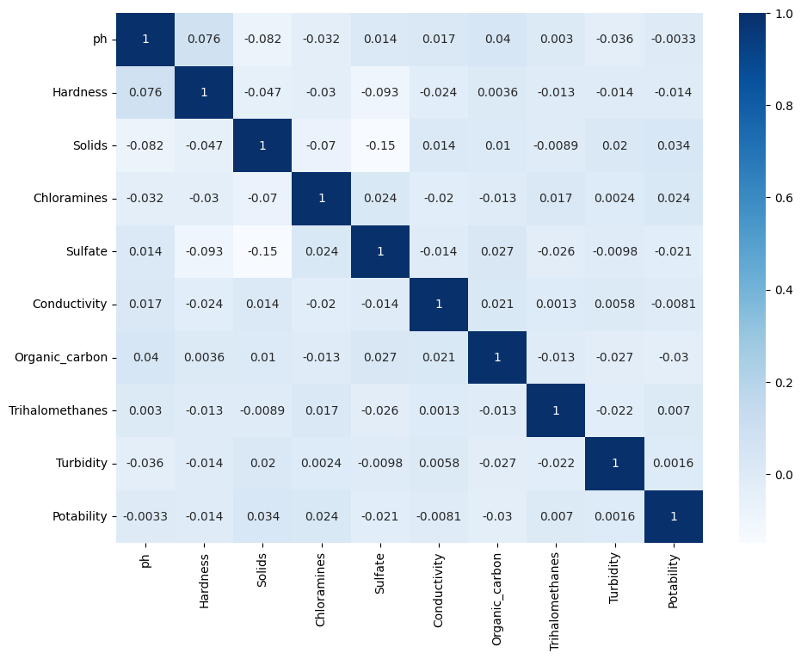
White Grid :
Heatmap :

Slide 10
Conclusion and Call to Action
1
Prioritizing Water Quality Analysis
Continuously analyzing water quality is key in protecting public health and the environment.
2
Encouragement to Take Action
Every individual can play their part in improving water quality, by taking personal responsibility in the efficient use of water, avoiding the release of pollutants, and advocating for positive change.

